Slide 1
Theory of Computation
In theoretical computer science and mathematics, the theory of computation is the branch that deals with how efficiently problems can be solved on a model of computation, using an algorithm.
It not only includes computers (e.g. digital computers, mechanical computers, quantum computers, DNA computers, molecular computers, microfluidics-based computers, analog computers, … ), but also anything or any machine who does some sort of computations, like calculators, abacuses, etc.
It comprises the fundamental mathematical properties of computer hardware, software, and certain applications thereof.
Notes:
This is the most abstract course in the whole curriculum of computer science.
It is one of the most fundamental courses for any computer scientist to know.
This course is not going to help you write a program per se (in and itself). And it is not going to help you build a computer per se.
But, it help you understand a lot more about what people have thought about in the last 60 years about computer science as a science. [And it’s about what kind of things can we really compute mechanically, how fast can we do it and how much space does it take us to do and how much memory does it take us to do it]
[In studying this subject we seek to determine what can and cannot be computed, how quickly, with how much memory, and on which type of computational model.]

Slide 2
Theory of Computation
Book Recommendation:
1. Introduction to Theory of Computation
--- By Anil Maheshwari, Michiel Smid,
Carleton University, Ottawa, Canada, 2016. 2. Introduction to Languages and The Theory of Computation.
--By John C. Martin
North Dakota State University, 2010

Slide 3
What is Computation?
Simply, computation is any type of calculation that follows a well-defined model understood and expressed as, for example, an algorithm.
Computation is finding an answer by using mathematics or logic.
You can use a computer to do computations.
But you can also do computations yourself when you add, subtract, multiply, etc.
Notes:
Theory of Computation is a very high level or abstract description of computers, it teaches us the principles behind computing. It describes various computing models, their "language/grammar“, their capabilities, etc.
Study of algorithms on the other hand include classification of algorithms into various groups like dynamic programming, greedy, branch and bound to solve various specific problems in computing like sorting, searching, pattern matching etc.

Slide 4
Theory of Computation: A Historical Perspective
Alan Turing studies Turing machines
Decidability
Halting problem
1930s
“Finite automata” machines studied
Noam Chomsky proposes the “Chomsky Hierarchy” for formal languages
1940-1950s
1969
Cook introduces “intractable” problems or “NP-Hard” problems
Modern computer science: compilers, computational & complexity theory evolve
1970-
4
Notes:
This field of research was started by mathematicians and logicians in the 1930’s, when they were trying to understand the meaning of a “computation”. A central question asked was whether all mathematical problems can be solved in a systematic way. The research that started in those days led to computers as we know them today.

Slide 5
Theory of Computation: A Historical Perspective
Alan Turing studies Turing machines
Decidability
Halting problem
1930s
“Finite automata” machines studied
Noam Chomsky proposes the “Chomsky Hierarchy” for formal languages
1940-1950s
1969
Cook introduces “intractable” problems or “NP-Hard” problems
Modern computer science: compilers, computational & complexity theory evolve
1970-
5
Notes:
Right before computers introduced, Alan Turing, an English mathematician, was interested in finding answer the question-
“what a computing machine can do? And, what it cannot?”
He was able to invent a machine called Turing machine.
In course of studies, Alan Turing classified problems into two types: 1) solvable problems and 2) unsolvable problems.
The halting problem is the problem of determining whether the program will finish running (i.e., halt) or continue to run forever.
After Alan Turing, around 1940’s, scientists started using a new computing machine called finite automata. It was initially introduced to model brain, but be found to failure. So they used the finite automata to model small and small applications.
And around 1950’s, Noam Chomsky, American linguistic, came to the concept of grammars.
Grammars are some formalism should have an relationship with finite automata which has various applications which will be seen later.
In the 1969, Stephen Kook, another mathematician, extended Turing’s work. He is interested in this question (Alan Turing’s question). Ok, we know the some problems are solvable. But, what are the problems solvable efficiently and what problems cannot be solved efficiently? By efficiently he means something that you can do quickly with lesser amount of both time and space.
So, basically we get hierarchy.

Slide 6
Theory of Computation: A Historical Perspective
Alan Turing studies Turing machines
Decidability
Halting problem
1930s
“Finite automata” machines studied
Noam Chomsky proposes the “Chomsky Hierarchy” for formal languages
1940-1950s
Cook introduces “intractable” problems or “NP-Hard” problems
1969
Modern computer science: compilers, computational & complexity theory evolve
1970-
6
Notes:
After Alan Turing, around 1940’s, scientists started using a new computing machine called finite automata. It was initially introduced to model brain, but be found to failure. So they used the finite automata to model small and small applications.
And around 1950’s, Noam Chomsky, American linguistic, came to the concept of grammars.
Grammars are some formalism should have an relationship with finite automata which has various applications which will be seen later.
In the 1969, Stephen Kook, another mathematician, extended Turing’s work. He is interested in this question (Alan Turing’s question). Ok, we know the some problems are solvable. But, what are the problems solvable efficiently and what problems cannot be solved efficiently? By efficiently he means something that you can do quickly with lesser amount of both time and space.
So, basically we get hierarchy.

Slide 7
Theory of Computation: A Historical Perspective
Alan Turing studies Turing machines
Decidability
Halting problem
1930s
“Finite automata” machines studied
Noam Chomsky proposes the “Chomsky Hierarchy” for formal languages
1940-1950s
Cook introduces “intractable” problems or “NP-Hard” problems
1969
Modern computer science: compilers, computational & complexity theory evolve
1970-
7
Notes:
In the 1969, Stephen Kook, another mathematician, extended Turing’s work. He is interested in this question (Alan Turing’s question). Ok, we know the some problems are solvable. But, what are the problems solvable efficiently and what problems cannot be solved efficiently? By “efficiently” he means something that you can do quickly with lesser amount of both time and space.
So, basically we get hierarchy.

Slide 8
Problems Hierarchy
Problems
Alan Turing
Solvable
Unsolvable
Stephen Kook
Tractable
Intractable
Notes:
A problem that can be solved efficiently, known as tractable problem.
A Problem that cannot be solved efficiently, known as intractable problem.
What is meant for intractable problem?
The problem for which you cannot find solution efficiently using a computing machine except for small instances, is known as intractable problem. With more advanced computing machines, the intractable problems still remains intractable today. Though using computing machine it has been possible to invent a lot of software and application through this course, but the major motivation of the theory of computation is toward the intractable problems.
Moore’s Law.
Moore's Law asserts that the speed of computation of a single processor will be double approximately every two years. Informally, we can do twice as much work in the same time (or the same amount of work in half the time) while cost of those will be halves.

Slide 9
Moore’s Law
Moore's Law asserts that the speed of computation of a single processor will be double approximately every two years. Informally, we can do twice as much work in the same time (or the same amount of work in half the time) while cost of those will be halves.

Slide 10
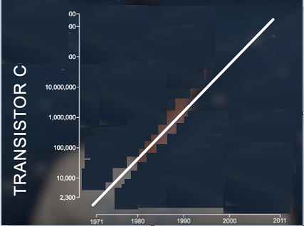
Moore’s Law

Slide 11
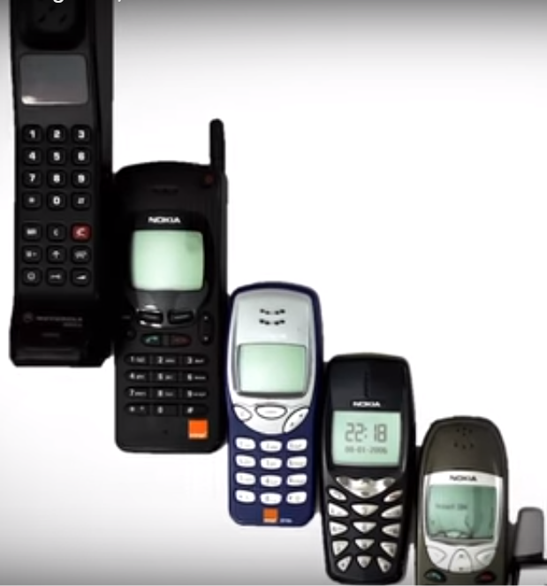
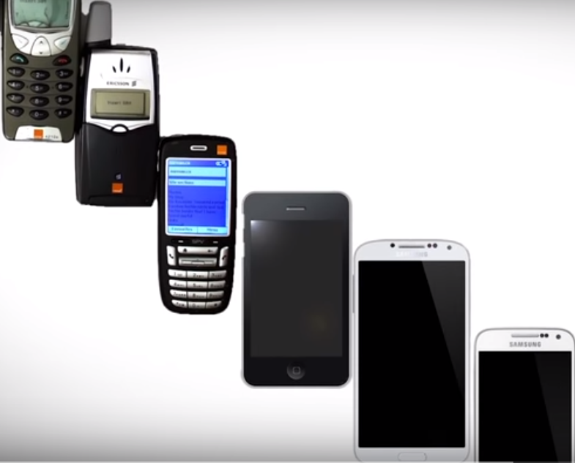

Slide 12
Applications of Theory of Computation
Compiler constructing
Natural language processing
Natural language Understanding
Artificial intelligence
text processing and searching applications
Cryptography, and so on.
Complex Circuit design
Notes:
Though this course is a core abstract course, there are lots and lots of applications that come about of this course.
1) All of compiler design and theory about building compilers and writing programs to translate languages comes from theory of ….
2) when you do string searching in any kind of word processing editor that uses a finite state machine comes from….
3) when you do any kind of compiling or representation of a language like XML you describe it with a grammar (another model of a computation) comes from….

Slide 13
Applications of Theory of Computation
Compiler design
Artificial intelligence
Natural language processing
Natural language Understanding
text processing and searching applications
Cryptography, and so on.
Circuit design
Notes:
When you talked about computer architecture you modeled a particular processor with a finite state machine (a kind of model of a computation), the idea of finite state machine originally comes from….
Every circuit that was presented was a combinatorial circuit. That means that its output is dependent only by its current inputs. Previous inputs for that type of circuits have no effect on the output.
(However, there are many applications where there is a need for our circuits to have “memory”; to remember previous inputs and calculate their outputs according to them. A circuit whose output depends not only on the present input but also on the history of the input is called a sequential circuit.)
Moore Finite State Machine: Its output is a function of only its current state, not its input.
Mealy Finite State Machine, where input affects the output.

Slide 14
What do we study in Theory of Computation?
This course tries to answer the following questions:
What are the mathematical properties of computer and hardware and software?
What is a computation and what is an algorithm? Can we give rigorous mathematical definitions of these notions?
What are the limitations of computers? Can “everything” be computed?
Notes:
Theory of computing will teach you even about things that cannot be computed (e.g. Halting Problem, Turing-Church Thesis and such), while “algorithm” is definitely about how to best compute (i.e. solve) various computational problems.
Theory of Computation is a very high level or abstract description of computers, it teaches us the principles behind computing. It describes various computing models, their "language/grammar“, their capabilities, etc. [Theory of computing describes various theoretical machines like finite automata, push-down automata, Turing machine and their capabilities.]
Study of algorithms on the other hand include classification of algorithms into various groups like dynamic programming, greedy, branch and bound to solve various specific problems in computing like sorting, searching, pattern matching etc.

Slide 15
What do we study in Theory of Computation?
The theory of computation can be divided into the three areas:
Complexity theory
Computability theory
Automata theory

Slide 16
Study in Complexity Theory
The main question asked in this area is “What makes some problems computationally hard and other problems easy?”
Informally, a problem is called “easy”, if it is efficiently solvable (i.e. tractable problem).
On the other hand, a problem is “hard”, if it cannot be solved efficiently, or if we don’t know whether it can be solved efficiently (i.e. intractable problem).
Efficiency is in terms of time and space.
Notes:
Example of “easy” problems are, a) sorting a sequence of 10,00,000 numbers, and b) searching for a name in a telephone directory, c) computing the fastest way from Dhaka to Rajshahi.
Example of “hard” problems are, a) time table scheduling for all courses at Engineering faculty, b) factoring a 300-digit integer into its prime factors, and c) computing a layout for chips in VLSI.

Slide 17
Study in Computability Theory
What is computable, and what is not?
i.e. what a computer can do and cannot do.
Example:
Classify problems as
Solvable
unsolvable
Notes:
Are you trying to write a non-existing program?
For example of a such a problem is “Is an arbitrary mathematical statement true or false?”

Slide 18
Study in Automata Theory
Automata theory is the study of abstract machines and the computational problems that can be solved using these machines. These abstract machines are called automata.
Notes:
In order to perform a rigorous study of computation, computer scientists work with a mathematical abstraction of computers called a model of computation.
Automata comes from the Greek word (Αυτόματα) which means that something is doing something by itself.

Slide 19
Study in Automata Theory
Automata theory is the study of abstract machines (or more appropriately, abstract 'mathematical' machines or systems) and the computational problems that can be solved using these machines. These abstract machines are called automata.
Notes:
Here is the way we will think about a computer: It receives some input, in the form of a string of characters; it performs some sort of “computation”; and it gives us some output.
In context of our course, it’s even simpler than that, because the questions
we will be asking the computer can all be answered either yes or no. For example,
we might submit an input string and ask, “Is it a legal algebraic expression?” At
this point the computer is playing the role of a language acceptor.
Accepting a language is approximately the same as solving a decision problem, by receiving a string, answering either yes or no. Many interesting computational problems can be formulated as decision problems.
Our first model is known as finite automaton.

Slide 20
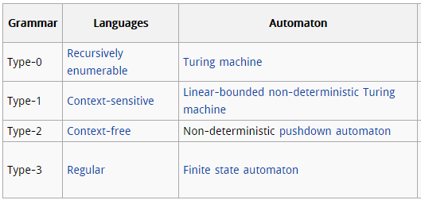
Notes:
[ A Turing machine is a mathematical model of computation that defines an abstract machine,^{[1]} which manipulates symbols on a strip of tape according to a table of rules.^{[2]} Despite the model's simplicity, given any computer algorithm, a Turing machine capable of simulating that algorithm's logic can be constructed. ]
Our first model is known as finite automaton. Languages that can be accepted by finite automata are regular languages; they can be described by regular expressions and generated by regular grammars.
One step up from a finite automaton is a pushdown automaton, and the languages these devices accept are context-free languages, can be generated by more general grammars called context-free grammars. Context-free grammars can describe much of the syntax of high-level programming languages, as well as related languages like legal algebraic expressions.
The most general model of computation we will study is the Turing machine, which can in principle carry out any algorithmic procedure. It is as powerful as any computer. Turing machines accept recursively enumerable languages, and one way of generating these is to use unrestricted grammars.

Slide 21
Notes:
One step up from a finite automaton is a pushdown automaton, and the languages these devices accept are context-free languages, can be generated by more general grammars called context-free grammars. Context-free grammars can describe much of the syntax of high-level programming languages, as well as related languages like legal algebraic expressions.
The most general model of computation we will study is the Turing machine, which can in principle carry out any algorithmic procedure. It is as powerful as any computer. Turing machines accept recursively enumerable languages, and one way of generating these is to use unrestricted grammars.

Slide 22
Notes:
The most general model of computation we will study is the Turing machine, which can in principle carry out any algorithmic procedure. It is as powerful as any computer. Turing machines accept recursively enumerable languages, and one way of generating these is to use unrestricted grammars.
In fact, a Turing machine is an implementation of an algorithm.
We said earlier that Turing machines accept recursively enumerable languages. These are not all languages, and Turing machines can’t solve every problem. When we find a problem a finite automaton can’t solve, we can look for a more powerful type of computer, but when we find a problem that can’t be solved by a Turing machine (and we will discuss several examples of such “undecidable” problems), we have found a limitation of the algorithmic method.

Slide 23
Mathematical notations and Preliminary
Notes:
A model of computation that is inherently simple, such as a finite automaton, is one we can understand thoroughly and describe precisely, using appropriate mathematical notation.
Having a firm grasp of the principles governing these devices makes it easier to understand the notation, which we can then apply to more complicated models of computation.

